Slide 1
Literature Review

Slide 2
What is literature review?
Literature
review
Introduction
Methods
Results
Discussion
Major works
Reviewed (Snapshots)
Relationship
Notes:
the purpose of an introduction is to briefly introduce the text to the readers whereas the purpose of a literature review is to review and critically evaluate the existing research on a selected research area.

Slide 3
Why do a literature review?
Provide background information/importance needed to understand your research
Improve your understanding on the research topic
Places your research as one link in a chain of research in your field (understand what came before you)
Justify the research, Critique previous research and Identify gaps or controversies in previous research
Notes:
Critique- Through assessment and detailed analysis of your research topic.

Slide 4
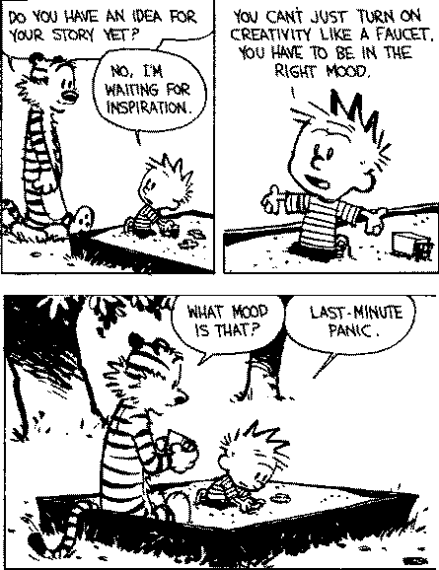
Steps for writing a literature review
Collect sources
Analyze/Scan (Abstract, Conclusion)
Summarize
Synthesize/Categorize
Drafting/Integrate

Slide 5
STRUCTURE of your literature review
Title
Introduction
Body (Arguments/Results)
Conclusion
Bibliography/References

Slide 6
Introduction
Make it brief (~1/5 of the paper’s total length)
Introduce the research topic (what it is, why does it matter)
Frame the story: Tell the reader why it is important that you reviewed the literature in your topic area
Briefly outline how you have organized the review
Notes:
Grab the reader’s interest while introducing the topic.

Slide 7
BODY
Headings. Use theme headings to organize your argument
Describe important results/findings and explain how those results shape our current understanding of the topic
Compare the studies if need be, to discuss their implications (i.e., your interpretation of what the studies show and whether there are important differences or similarities)
Use figures/tables to present your own synthesis of original data/interpretation
Notes:
Describe, compare, and evaluate studies for each section of your argument

Slide 8
How to organize your Arguments/ideas (The body)
Topical
Compare-Contrast
Advantages-Disadvantages
Cause-Effect
Problem-Solution
Chronological

Slide 9
Topical/Thematic
Purpose: Describe various types of wine
I. Red Wines
A. European
B. Californian
II. White Wines
A. European
B. Californian

Slide 10
COMPARE-CONTRAST
Purpose: To help readers make an informed decision about whether to attend a two-year college or a four-year university
I. Cost of Tuition
1. Two-year
2. Four-year
II. Quality of Education
1. Two-year
2. Four-year

Slide 11
ADVANTAGES-DISADVANTAGES
Purpose: Advantages and disadvantages of attending a two-year college
I. Advantages
1. Cost
2. Accessibility
II. Disadvantages
1. Number of educational programs
2. Quality of instruction
Notes:
GOOD AND BAD
PRO AND CONS

Slide 12
CAUSE-EFFECT
Purpose: Explain the causes of conflict escalation and their effects
I. Causes of Conflict Escalation
1. Expanding the issues
2. Personal attacks
II. Effects of these causes
1. Lose focus on original issue
2. Cycle of defensive responses
3. Negative emotions

Slide 13
PROBLEM-SOLUTION
Purpose: To persuade his readers to ride bicycles as their primary form of transportation
I. Problem: Motorized Transportation
1. Increasing traffic congestion
2. Increasing pollution
3. Increasing road rage from traffic-related stress
II. Solution: Riding Bicycles
1. Reduces number of vehicles in use
2. Is not a source of pollution
3. Has physical and psychological health benefits

Slide 14
Chronological
Purpose: Historical development and evolution of the city of Seattle
I. 1920-1945
1. Significant Event #1
2. Significant Event #2
II. 1945-1970
1. Significant Event #1
2. Significant Event #2

Slide 15
How to organize your Argument/ideas (The body)
Geographical
Questions-Answers
Series of Advancement
Ancient-Modern
Myths-Realities
Effective-Ineffective

Slide 16
CONCLUSION
Final evaluation, summation of major points
Point out the significance of these results
Discuss the questions that remain in the area
Keep it brief
Notes:
Groundwork for future work

Slide 17
REFERENCES
8-12 sources
accurate in-text citations
complete and correct citations for every source

Slide 18
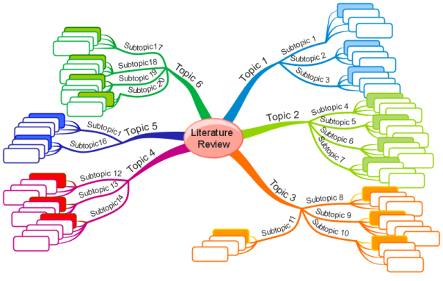
STRATEGIES FOR LITERATURE REVIEW
Outline of literature review
Mind Mapping

Slide 19
Synthesizing Literature
http://gseacademic.harvard.edu/~instruct/gutman_library/litreview/synthesize/player.html

Slide 20
What does it mean to Synthesize Articles?
What it is not…..
What it is…..
separate parts/ideas lined up next to one another
Integration of support from more than one source for one idea/argument
Identification of how sources are related

Slide 21
Attribution Verbs instead of “says
Specific verbs to use to cite someone else’s opinion or information.
Examples:
Adds | Concludes | Illustrates
Acknowledges | Expresses | Implies
Analyzes | Declares | Indicates
Asserts | Defines | Interprets
Believes | Describes | Proposes
Claims | Emphasizes | Reasons
Comments | Finds | States

Slide 22
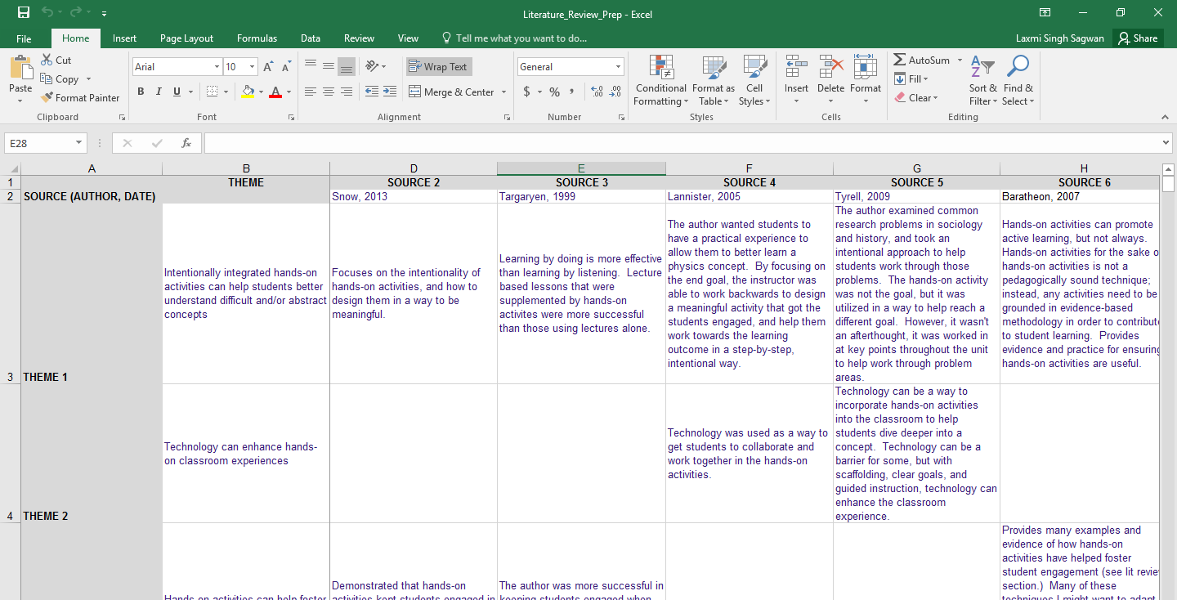
Track information consistently

Slide 23
Sexual harassment has many consequences. Adams, Kottke, and Brown (1983) found that some women students said they avoided taking a class or working with certain professors because of the risk of harassment. They also found that men and women students reacted differently. Their research was a survey of 1,000 men and women graduate and undergraduate students. Benson and Thomson's study in Social Problems (1982) lists many problems created by sexual harassment. In their excellent book, The Lecherous Professor, Whiles and Walker (1990) give a long list of difficulties that victims have suffered.
The victims of sexual harassment suffer a range of consequences, from lowered self-esteem and loss of self-confidence to withdrawal from social interaction, changed career goals, and depression (Adams, Kottke, and Brown, 1983; Benson and Thomson, 1982; Whiles and Walker, 1990). For example, Adams, Kottke, and Padgitt (1983) noted that 13 percent of women students said they avoided taking a class or working with certain professors because of the risk of harassment.

Slide 24
Assignment
1) Does the introduction clearly present the research topic (including context, problem, purpose)?
2) Does the introduction highlight an outline as to how the review is organized?
3) Does the writer use one of the discussed strategies to organize their arguments/ideas?
4) Does the conclusion present a judgement idea to effectively end the review?
5) Does the writer use punctuation properly? Does the writer make use of hyphen, colons and semi-colons when appropriate?
6) Any suggestion to improve the review?

