Slide 1
Method and Methodology

Slide 2
Method vs Methodology
Method- Quantitative Research
Methodology - Qualitative Research
Describes the techniques/tools used to collect the data
Detailed enough for a good researcher to be able to replicate a study from reading a method section
Rationale for the research approach
Justification of approach to a research problem through logic and assumptions

Slide 3
Types of Method
Types | Description
Library based Research | 1) Analysis of documents- statistical analysis
Field based Research | 2) Personal, Focused and Group Interview- open and closed questions 3) Survey- Mail and Telephone 4) Non-participant direct observation 5) Participant observations- Recording, everyday observations
Laboratory based Research | Small group, controlled environment- Use of device to record data

Slide 4
Types of Methodology
Types | Description
Historiography | Writing of history based on critical examination of sources into a narrative
Ethnography | Explores the social world or culture, shared beliefs and behaviors
Phenomenology | Describes the “lived experience’ of a particular phenomenon
Grounded theory | Use an inductive approach to develop new theory
Ethnomethodology | Examine how people use dialogue and body language to construct a world view
Notes:
Observation and theories. Inductive = Gather Data- Look for Patterns- Develop

Slide 5
Participants
Who was in the study?
How many participants?
Sample size
Any important characteristics?
Both men and women?
Race/Ethnicity?
Age group?

Slide 6
Participants
Inclusion characteristics
Exclusion characteristics
Studies must clearly state if participants had to have any characteristics or meet certain requirements
Must have a diagnosis
Must be a parent-child pair
Must be married
Must be of a certain income range
Must be African American
Studies need to state clearly any exclusion characteristics or things that would mean that someone should not be in the study
Must not have a serious alcohol or drug problem

Slide 7
The Participants Section-Example
Participants
Participants were 239 (40 men and 199 women) undergraduates at a university in the Southeastern U.S. who completed a survey in exchange for credit toward a course requirement. Participants’ median age was 21, and they described themselves as White (55.6%), Black (18.8%), Latino/a (10.4%), Multiracial (5.4%), Asian (4.6%), Arabic (1.3%), and Other (3.8%). Because we focused here on an identity (nerd) whose cross-cultural and cross-linguistic generalizability was unknown to us, we restricted eligibility to native English speakers. Participation in this study was on a voluntary basis. Compensation in the form of extra credit and course credit for academic coursework was provided for some participants enrolled in specific undergraduate college courses. Participants who failed the manipulation check (n = 22) were excluded in further analyses.

Slide 8
The Participants -Example
Sample size?
Participants
Participants were 239 (40 men and 199 women) undergraduates at a university in the Southeastern U.S. who completed a survey in exchange for credit toward a course requirement. Participants’ median age was 21, and they described themselves as White (55.6%), Black (18.8%), Latino/a (10.4%), Multiracial (5.4%), Asian (4.6%), Arabic (1.3%), and Other (3.8%). Because we focused on an identity whose cross-cultural and cross-linguistic generalizability was unknown to us, we restricted eligibility to native English speakers. Participation in this study was on a voluntary basis. Compensation in the form of extra credit and course credit for academic coursework was provided for some participants enrolled in specific undergraduate college courses. Participants who failed the manipulation check (n = 22) were excluded in further analyses.
Who were the participants?
Important Characteristics?
Inclusion Characteristics?
What compensation they received?
Exclusion characteristics?
How many participants you did not analyze and why?

Slide 9
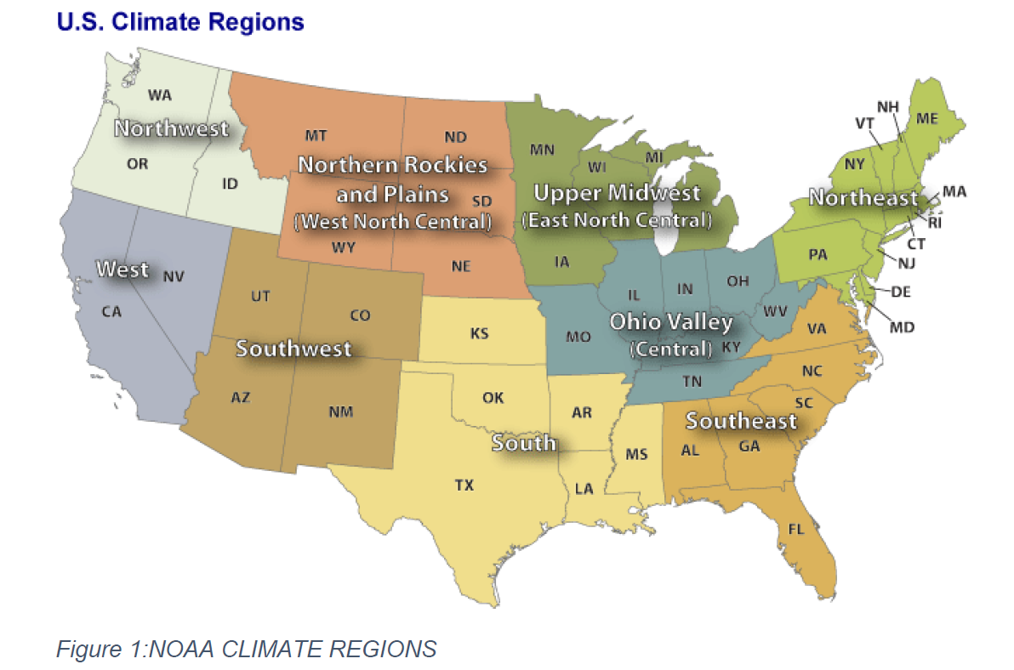
Study Area
Location detail
Google Earth/Map
GPS coordinates

Slide 10
Materials
All materials utilized for the study
Which ones were used? Why was it chosen?
testing instruments, books, images, database or other materials used in the course of research
Measures (Surveys/Interviews/observations) used for the study
must provide details about the measures, scale, interpretation of scores
When using a pre-existing published measure: Include full name of measure followed by abbreviation and citation of original author
Ex: Occupational Stress Indicator (OSI; Cooper, 1997) After that, you can call it the OSI
Notes:
What is the survey-short description as to what it is measuring measuring, scale, what would high scores mean

Slide 11
Materials
Drugs, Chemicals , Samples
Generic name, manufacturer, purity, concentration.
Eg. standards, dyes
Culture Media, buffers
Components and their concentrations, pH etc.
Eg. Phosphate buffer pH 7
Experimental Materials
Eg. Tissue, cell line etc.

Slide 12
Materials
Animals/Plants/Bacteria
State the species, weight, strain, sex, and age etc.
Handling and care
Details of sedation: agent used, amount, route, administration (single, continuous) etc.

Slide 13
Procedures
Sequences of procedures that make up an experiment (Tell a story)
Arrange them in sub headings

Slide 14
Experimental design
Independent variables
Variables manipulated (treatments)
Dependent variables
Variables measured
Control experiments or procedures
How many trials/replicates

Slide 15
Experimental Design Example
Design
The data were collected in four experimental conditions for 2 x 2 mixed-model ANOVA. Gender (male, female) was the between-subjects factor and Body type (thin, heavy) was the within-subjects factor. The rejection level for all analyses was set at p = 0.05.
Describes the experimental design, with factors, levels, and type of factor.

Slide 16
Data Analysis
Simple test- Mean, standard deviation (SD), standard error of the mean (SEM)
Statistical tests e.g. ANOVA, regression, descriptive statistics, t-tests, Chi square etc.
Instrument e.g. HPLC analysis (solvent, method, flow rate, temperature, column etc)

Slide 17
Data Analysis Example
All qPCR and transfection data were subjected to one-way ANOVA, and differences between individual means were tested by a Tukey multiple-range test using Prism version 4.0 software (GraphPad). Tests of significance were performed using the appropriate error terms according to the expectation of the mean squares for error. A P value of 0.05 or less was considered significant. Data are presented as least-square means ± SEM.

