Slide 1
Summarizing Journal Articles & Online Tools for Researchers
Laxmi Sagwan
McNair Program

Slide 2
Summarizing Journal Articles

Slide 3
What is a scholarly journal article?
Presents original research
Is discipline-specific
Is peer-reviewed

Slide 4
Anatomy of a Journal Article
Criminal Justice Journal Article
Engineering Journal Article
Title
Authors and their information
Abstract
Introduction
Prior Literature (Method, Data and Analysis)
Results
Discussion
Conclusions
References
Title
Authors and their information
Abstract
Introduction
Method
Results
Discussion
Conclusions
References

Slide 5
The purpose of summarizing
To give a short description of what is relevant to your
own research
The scaffold of your literature review
Synthesize articles

Slide 6
STEPS to Summarizing an article
Read the Abstract
What is an Abstract?
Short summary of the journal article (100- 200 words)
Important highlights of the research study and findings
A short clear summation of the entire paper

Slide 7
Structure of abstract
Background (Optional)
Research Question(s)/Objective(s)
What was done?
What was found?
Implication/Conclusion

Slide 8
Article summary worksheet

Slide 9
Source
Title of the paper,
Authors,
Journal Information

Slide 10
Purpose or Thesis Statement
What did they investigate and why did they want to?
Found in the Introduction
BROAD
A: Known (general topic)
B: Research Problem/Issue
NARROW
C: Importance and implied solution
D: Research Question/Hypothesis
E: Experimental approach

Slide 11
RESEARCH QUESTION(S) AND/OR HYPOTHESIS
What did they want to know and/or what did they think would happen?
To determine……..
Therefore, we tested the hypothesis that…..
This report describes experiments designed to determine whether…..
The present study was therefore designed to determine whether….

Slide 12
Method
Who were the participants/subjects, what instruments and procedure did they use, how were they planning to analyze the data?

Slide 13
Results/findings
What did they find?
Includes observations, data and findings
Figures, Tables, Statistics

Slide 14
CONCLUSION AND FUTURE RESEARCH
What do their findings mean?
What contributions did they make to the field?

Slide 15
CRITIQUE, LIMITATIONS AND UNANSWERED QUESTIONS
How could this study have been better?
How does your study fill the gap in their study?

Slide 16
STEPS to Summarizing an article
Eliminate wordiness
“The results clearly showed that there was no difference between the groups”
“There was no significant difference between the groups”
Use specific, concrete language
This illustrates
The result illustrates
Use scientifically accurate language
support or fail to support
Write in your own words
Notes:
Revisit the source just to confirm facts. Do not express an opinion.

Slide 17
STEPS to Summarizing an article
Synthesize articles
Group the articles under category on a shared topic
Combine the ideas, derive relationship among sources
Notes:
Similarities and differences in the studies

Slide 18
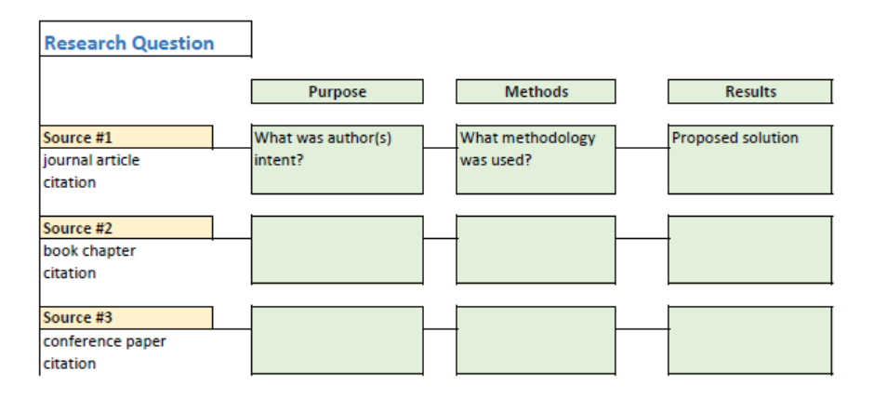

Slide 19
Online tools for researchers

Slide 20
wHAT CAN endnote (WEB) do for you?
Organizes and Management of your references (journal articles, book)
Make it easy to access
http://libguides.lib.siu.edu/endnoteweb
Cite papers as you write
https://www.youtube.com/watch?v=IkO1uJeOlvM

Slide 21
Other CITATION MANAGERS

Slide 22
Grammarly
Improves your writing, error-free
Proofreading
Plagiarism detection
https://www.grammarly.com/

Slide 23
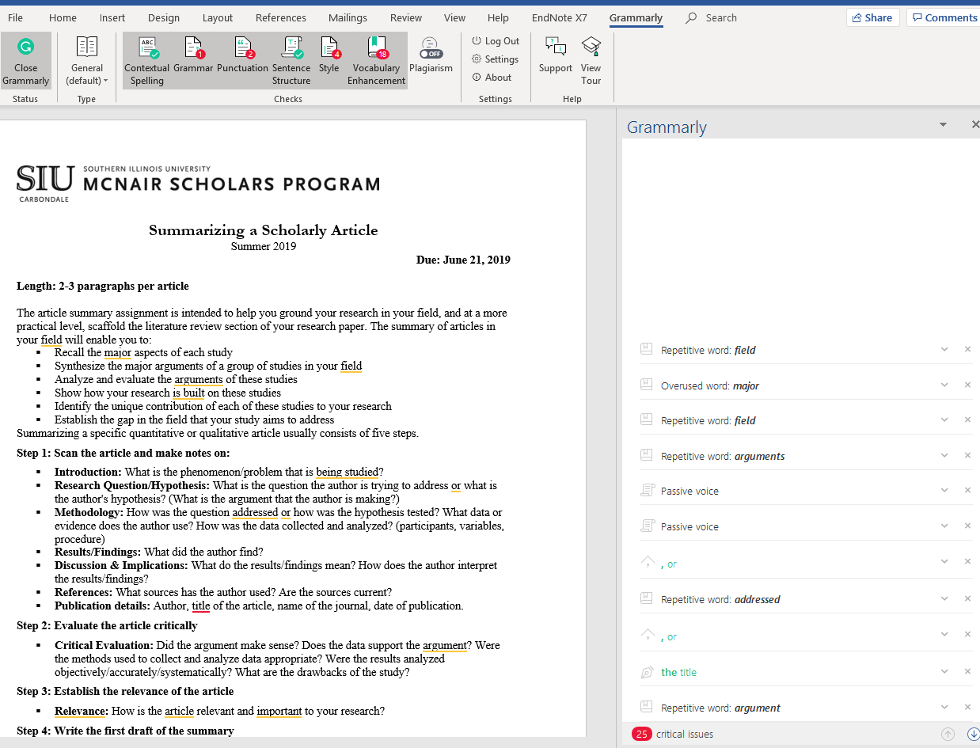

Slide 24
rESEARCHGATE
Social networking site
Facebook for scientists and researchers
Share paper, ask and answer questions, find collaborator
https://www.researchgate.net/

Slide 25
dROPBOX
Dropbox can create a special folder on the user's computer
synchronized to Dropbox's servers and to other computers and devices
Notes:
that the user has installed Dropbox on, keeping the same files up-to-date on all devices

Slide 26
SOFTWARE doWNLOADS
https://oit.siu.edu/salukitech/software/

